Slide 1

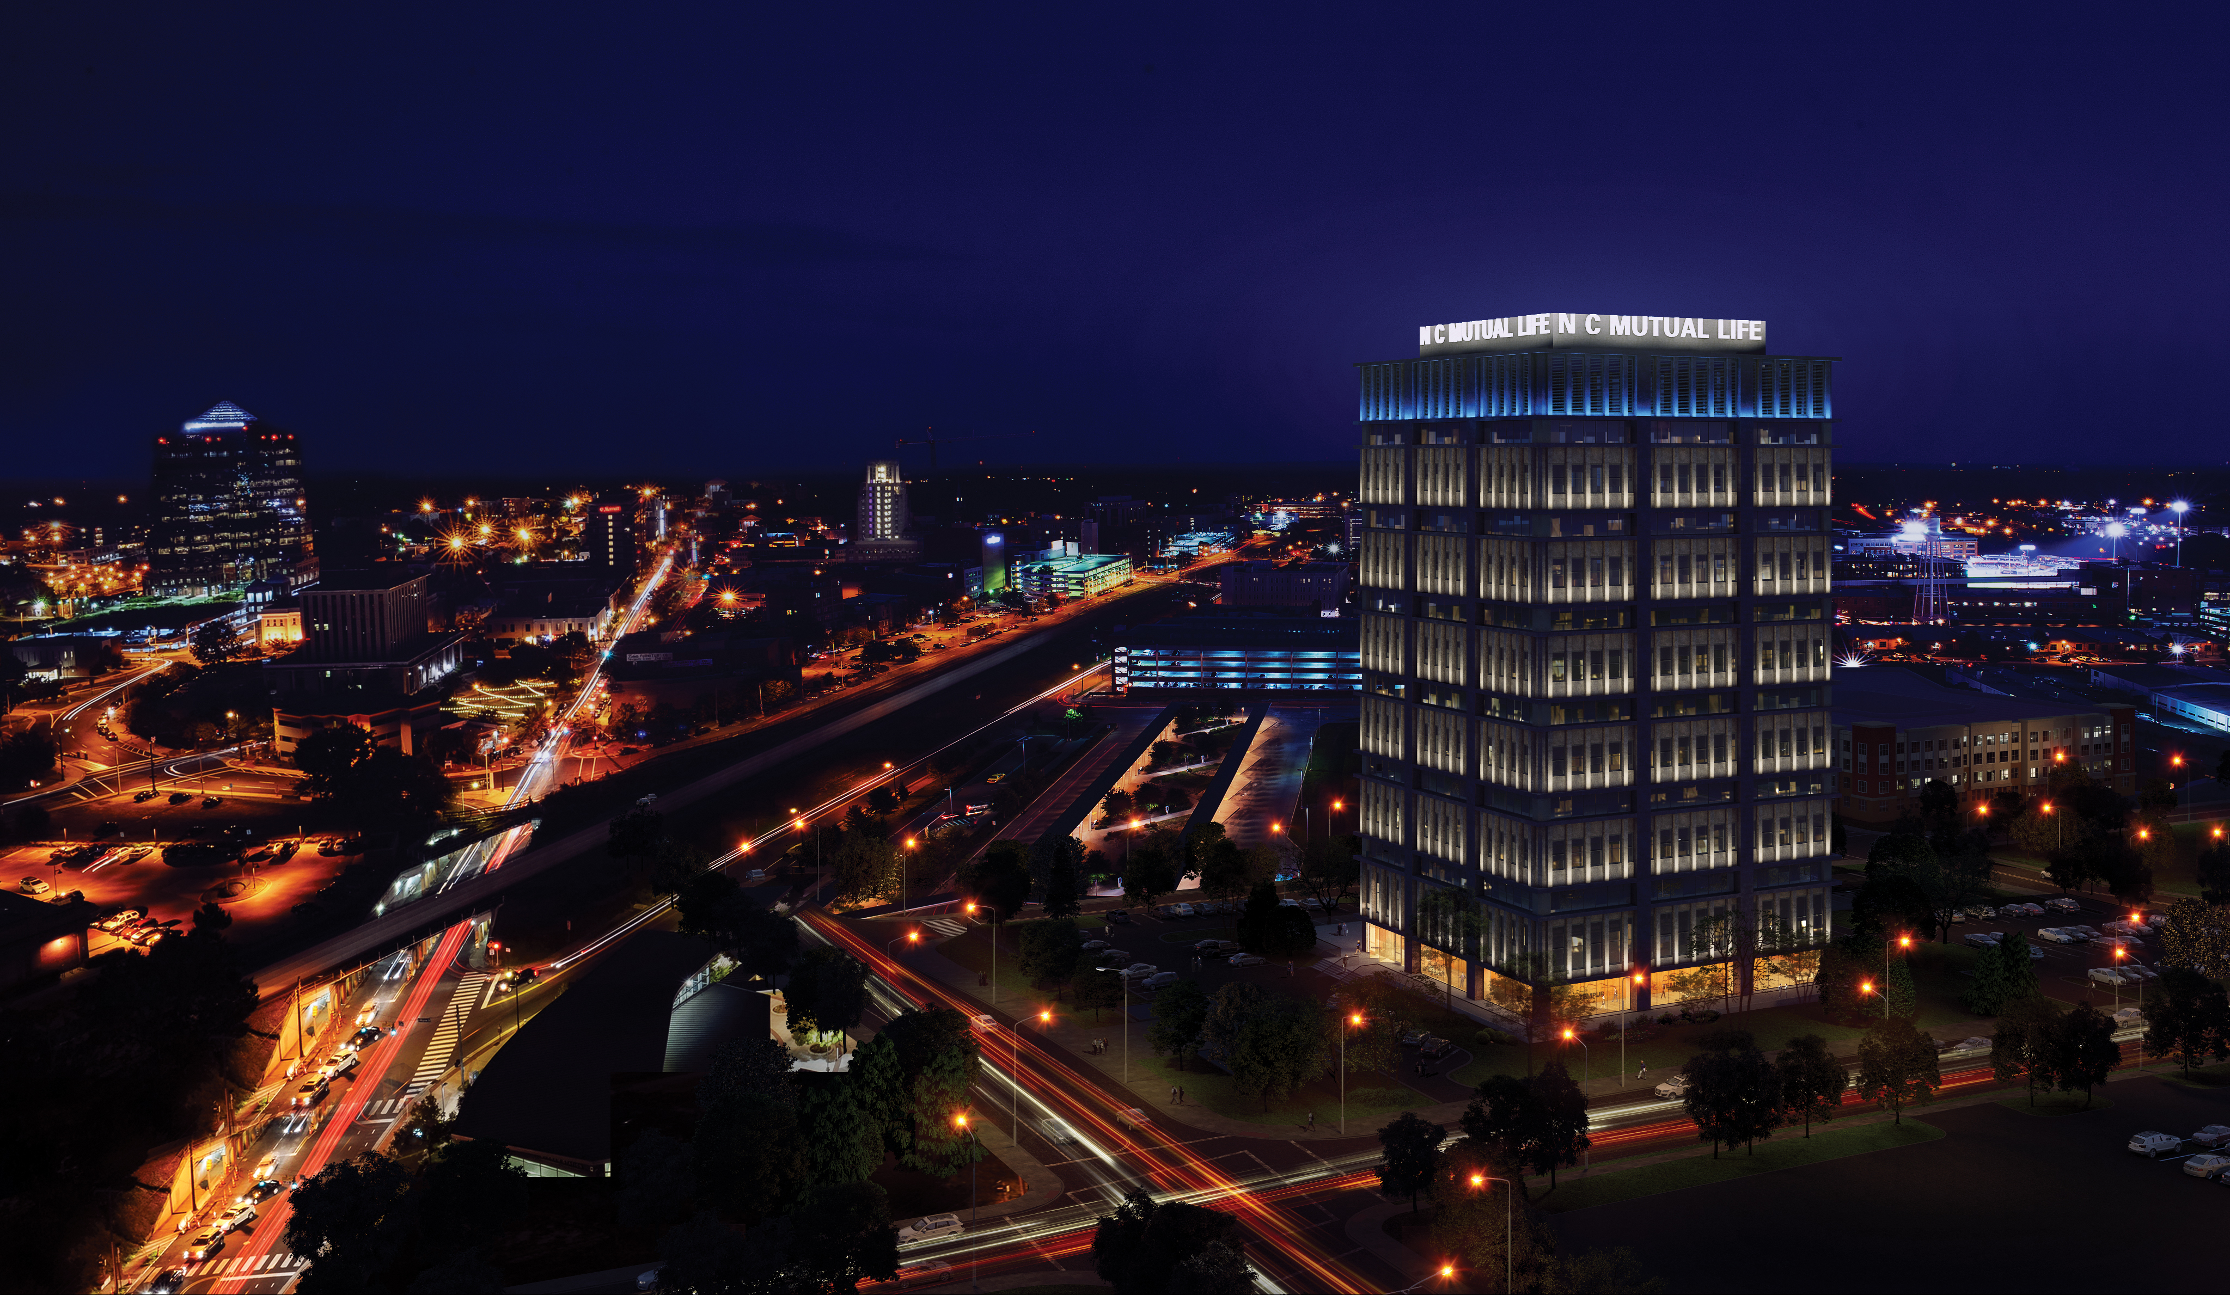
STANDING THE
TEST OF TIME
Breathing New Life into One of
Durham’s Most Prominent Office Towers

Slide 2
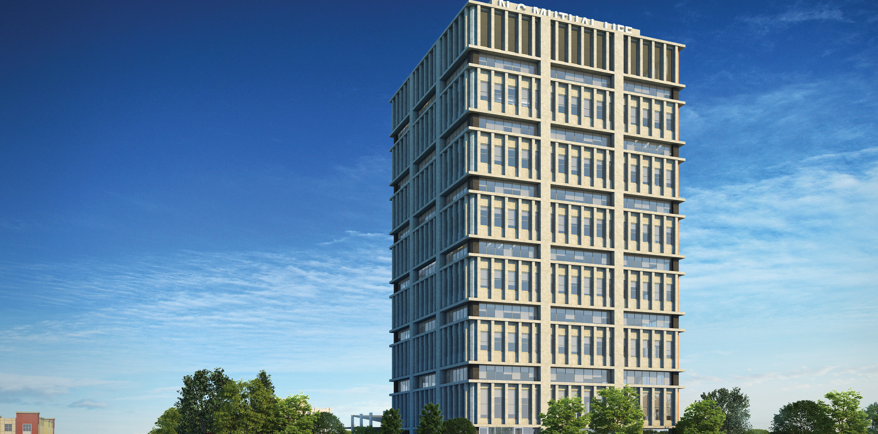
THE TOWER AT MUTUAL PLAZA REDEVELOPMENT
The Tower at Mutual Plaza is the $11M capital improvement project for one of Durham’s most acclaimed landmark buildings
Enhanced amenities and base building renovations will elevate the quality and functionality of the space for modern office users

Slide 3
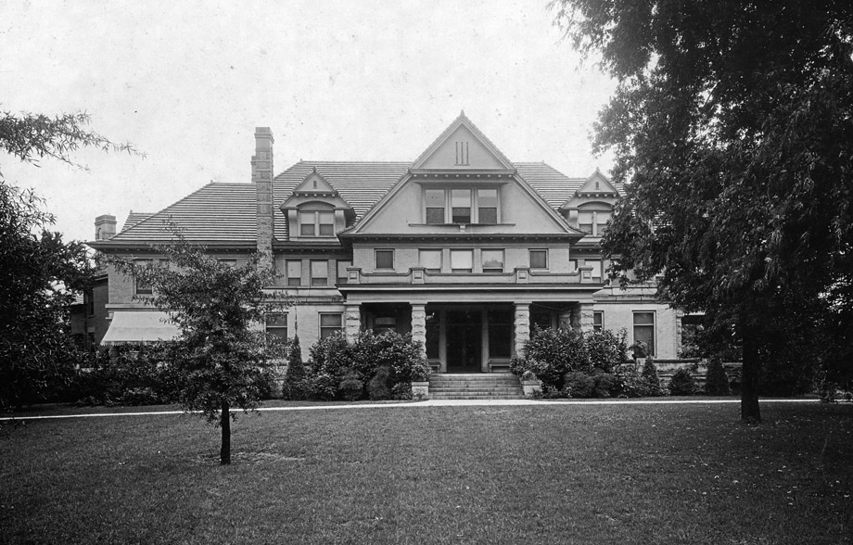
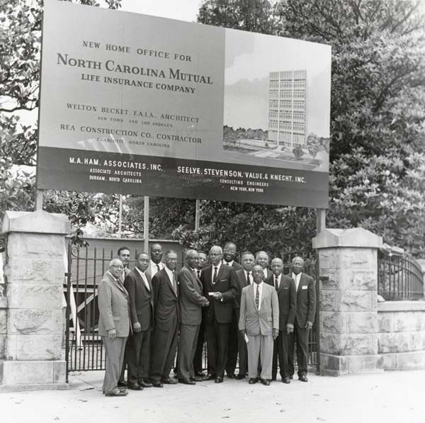
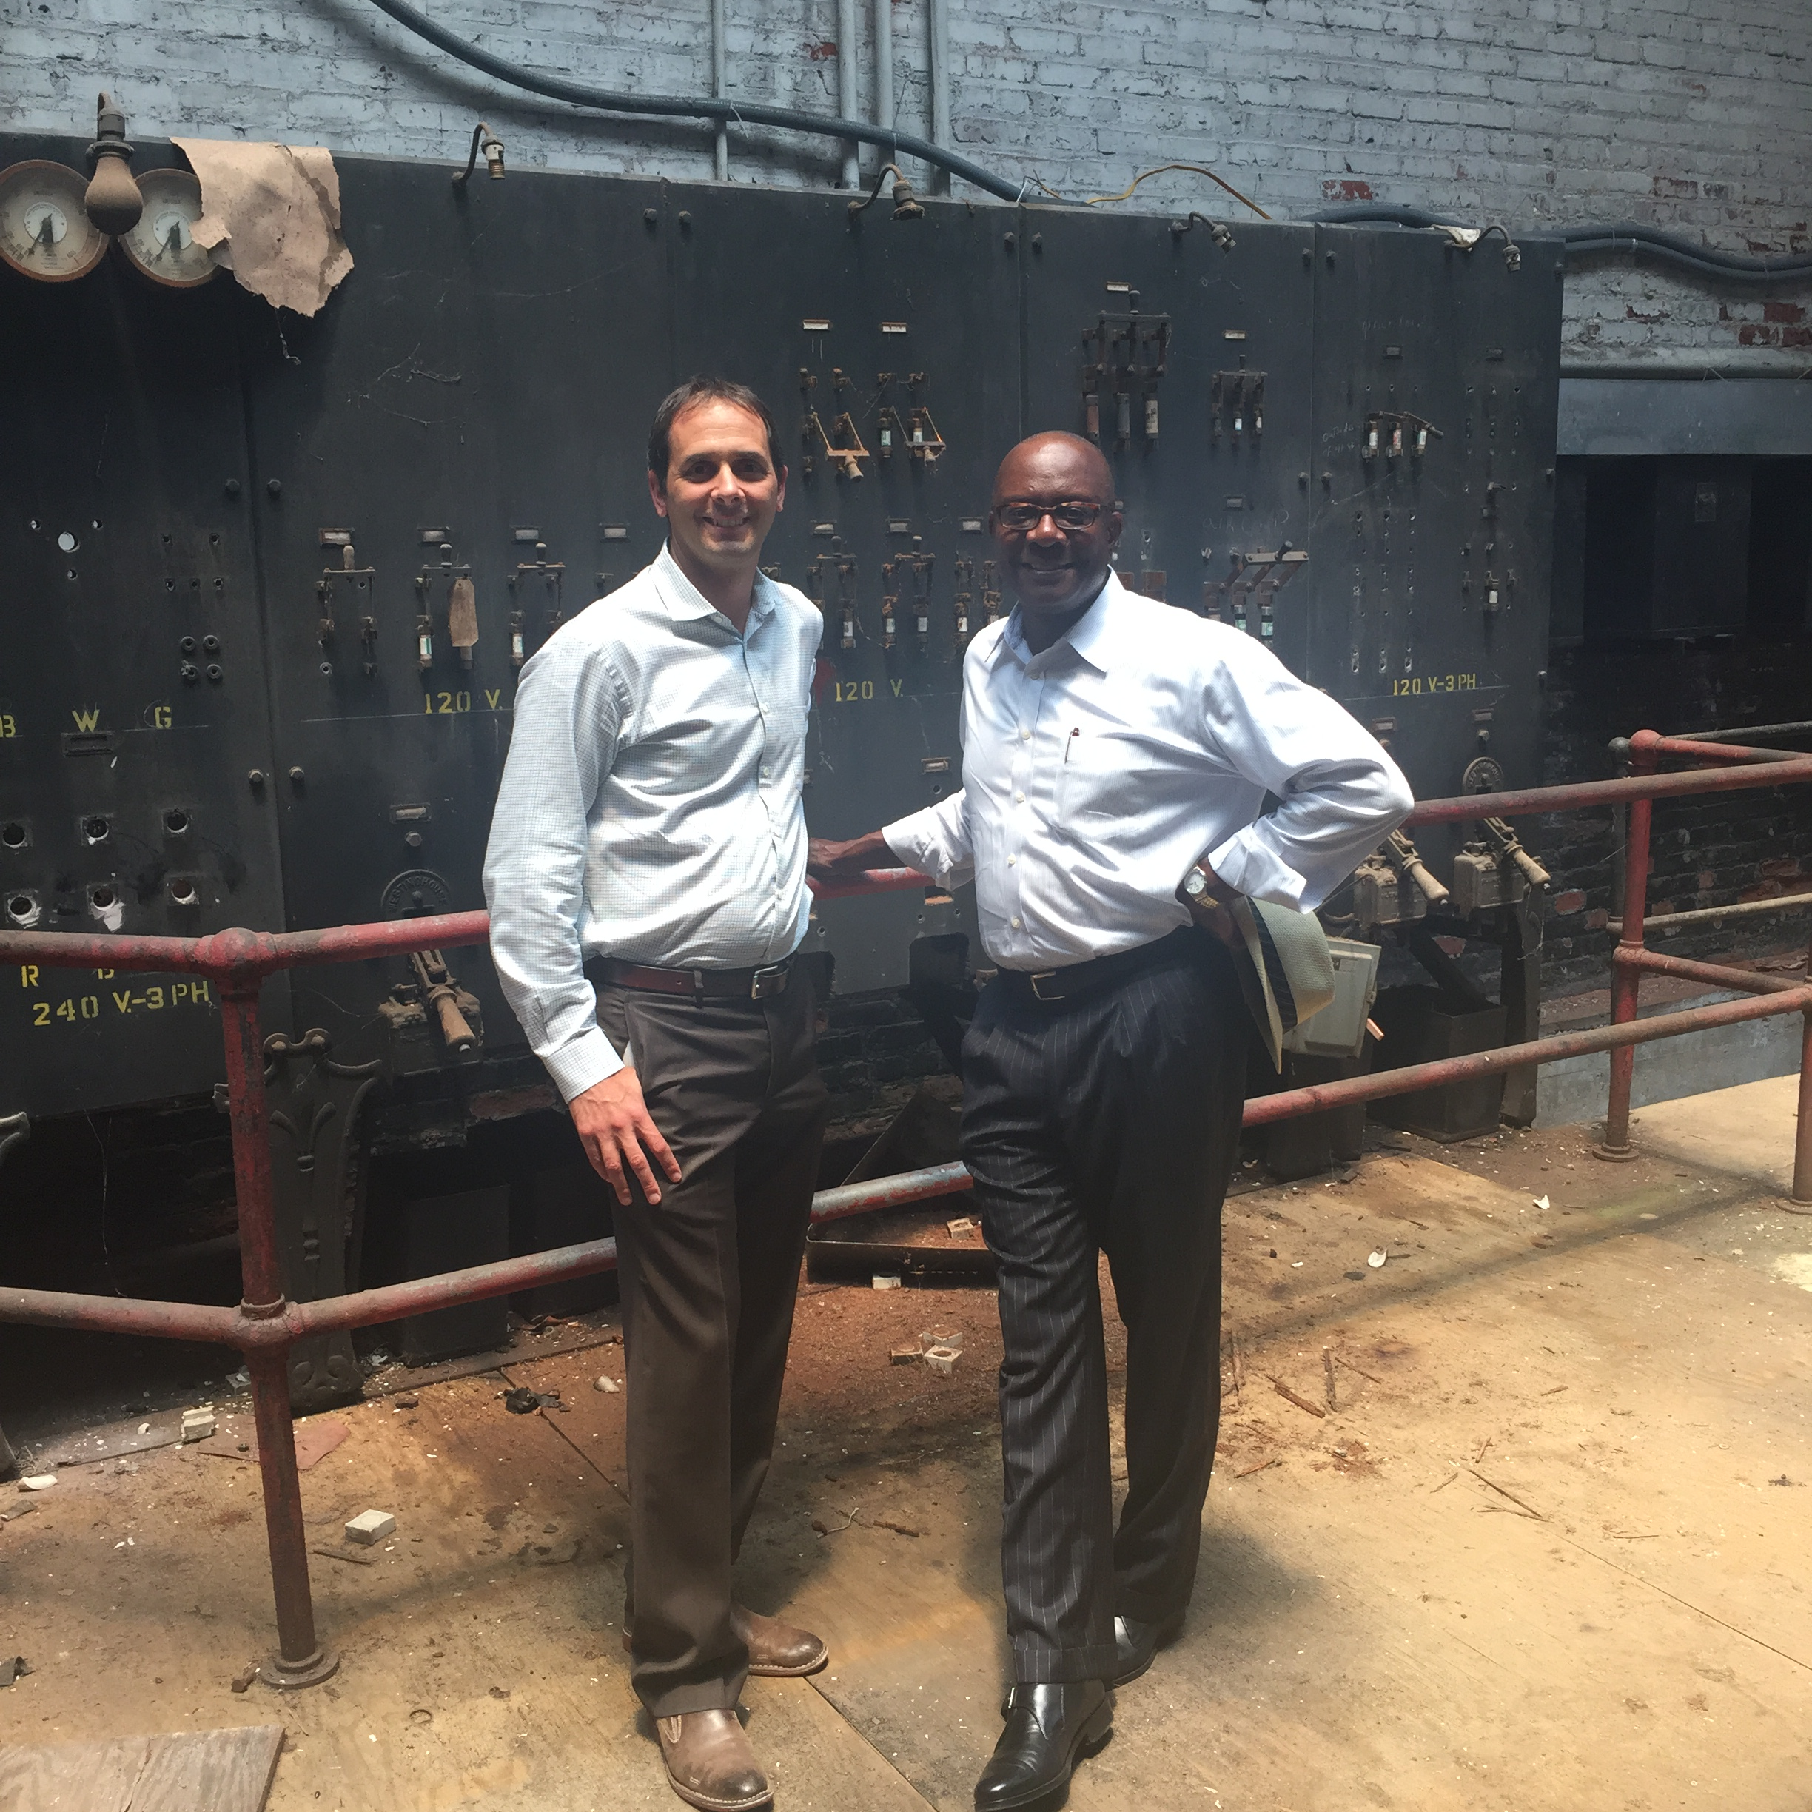
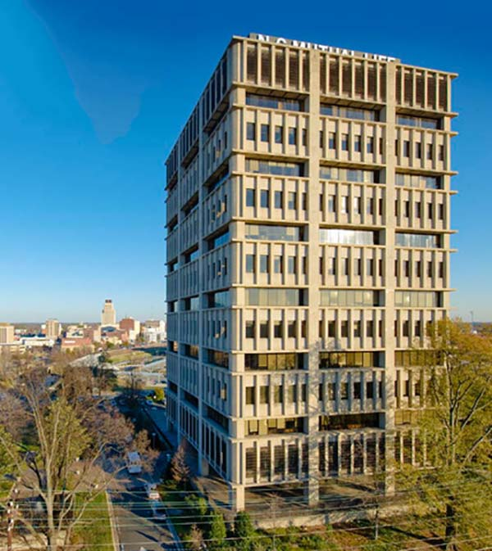
TRACING HISTORY
Duke sold property to NC Mutual Company, which began and completed construction of their headquarters (one of Fortune’s Top 10 Buildings of the Decade)
Michael Lemanski, Carl Webb, and a group of local investors were actively involved in the property’s acquisition and its redevelopment today
$11M capital improvement project begins led by Lemanski and Webb
Duke University inherited the home and used it as a guesthouse and reception area for 30 years
New development on the horizon
Site was location of two homes owned by Benjamin N. Duke
1800s
1920s - 1950s
1960 - 1964
2006
2017
2018

Slide 4
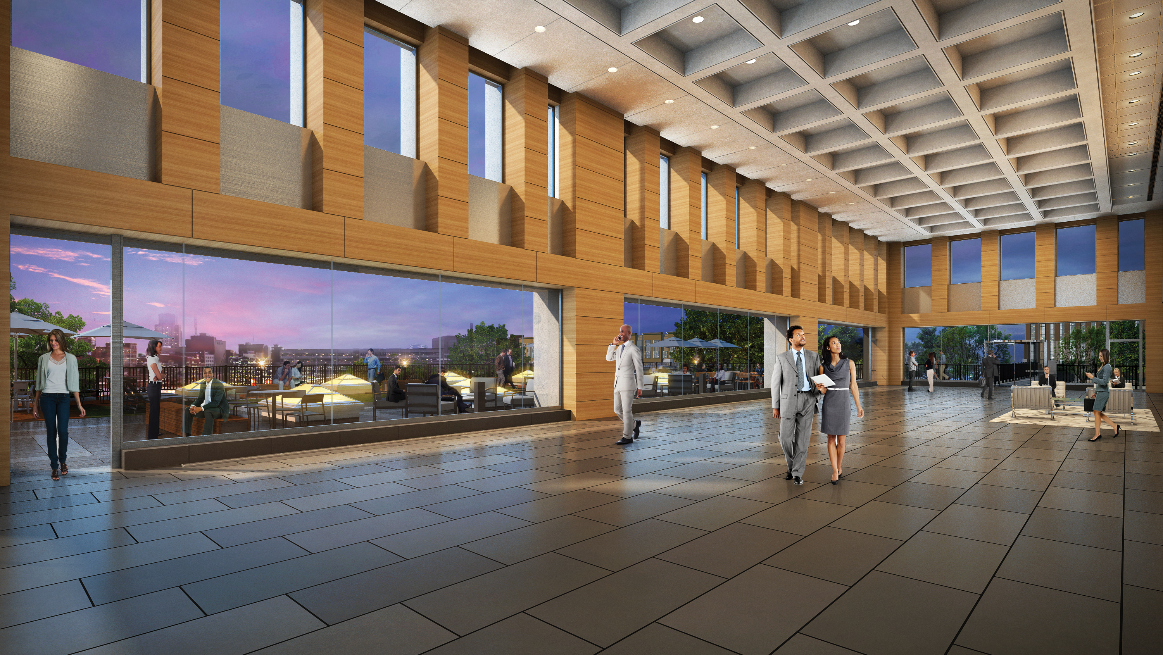
PROJECT TEAM
Built Form (Architecture)
Gilbane (Construction)
Avison & Young (Brokerage)
PDC (MEP)
McNamara-Salvia (Structural)
Stewart (Civil, Landscape,
Testing & Inspections)

Slide 5
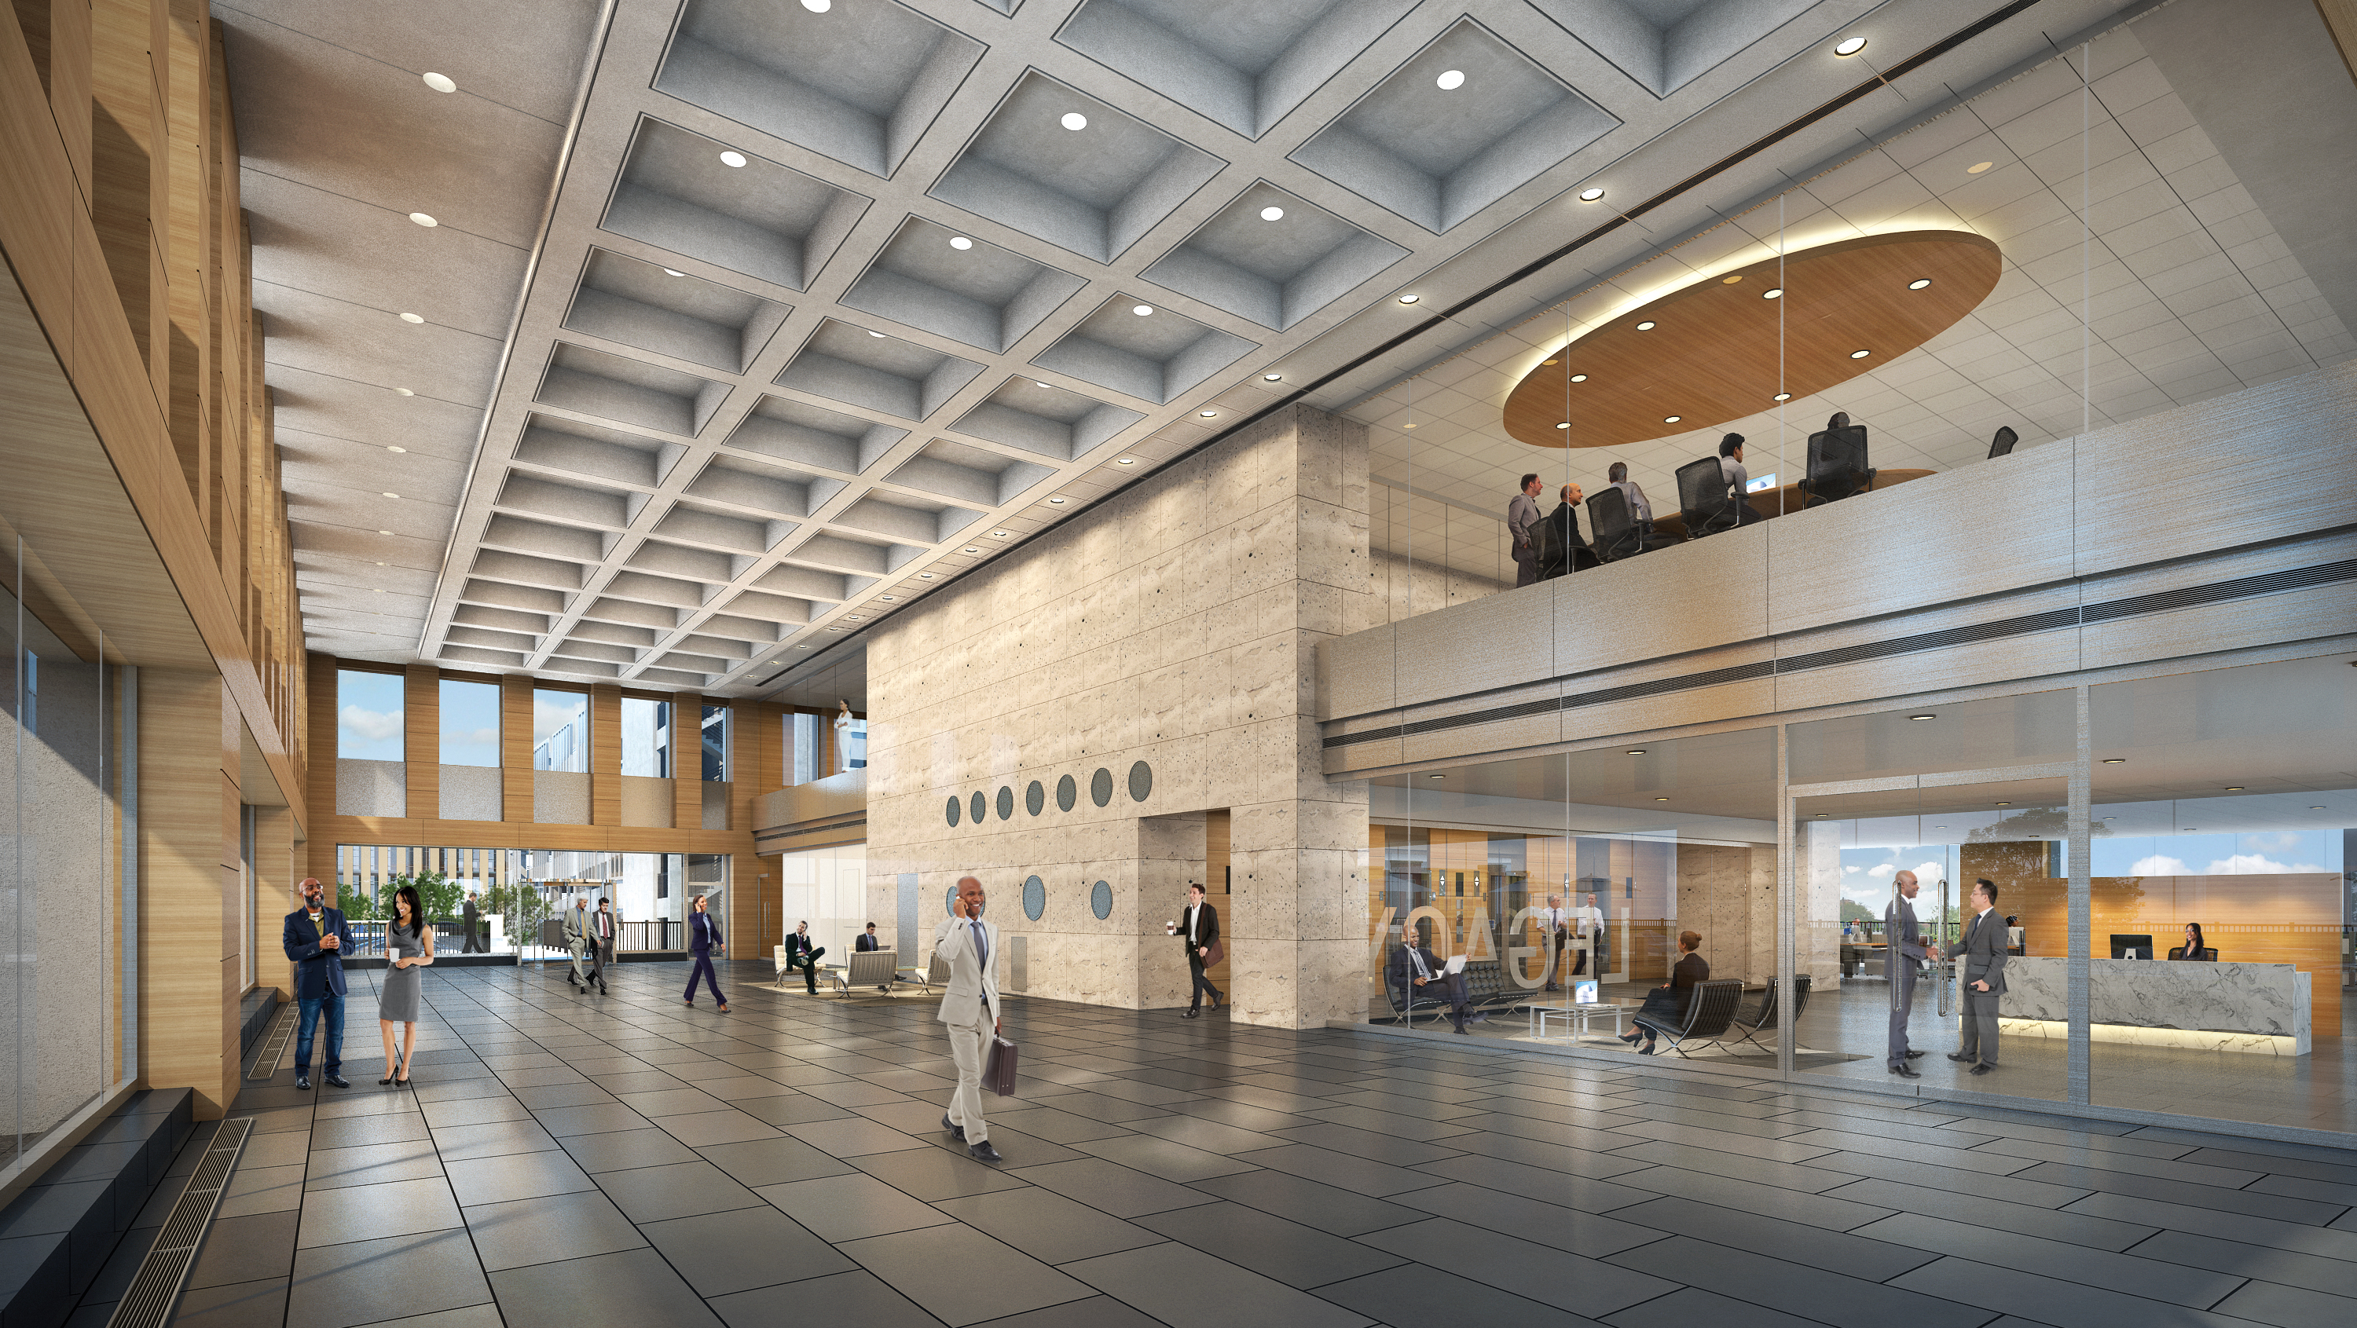
Reimagined Ground Floor
MODERN LOBBY
Remodeled and expanded with a glass curtain wall, revolving doors, stone flooring, wrapped columns, visitor restrooms, grab-and-go coffee and concessions
16,000 SF of newly constructed leasable space on first floor and mezzanine
Delivery in Q3 2018

Slide 6
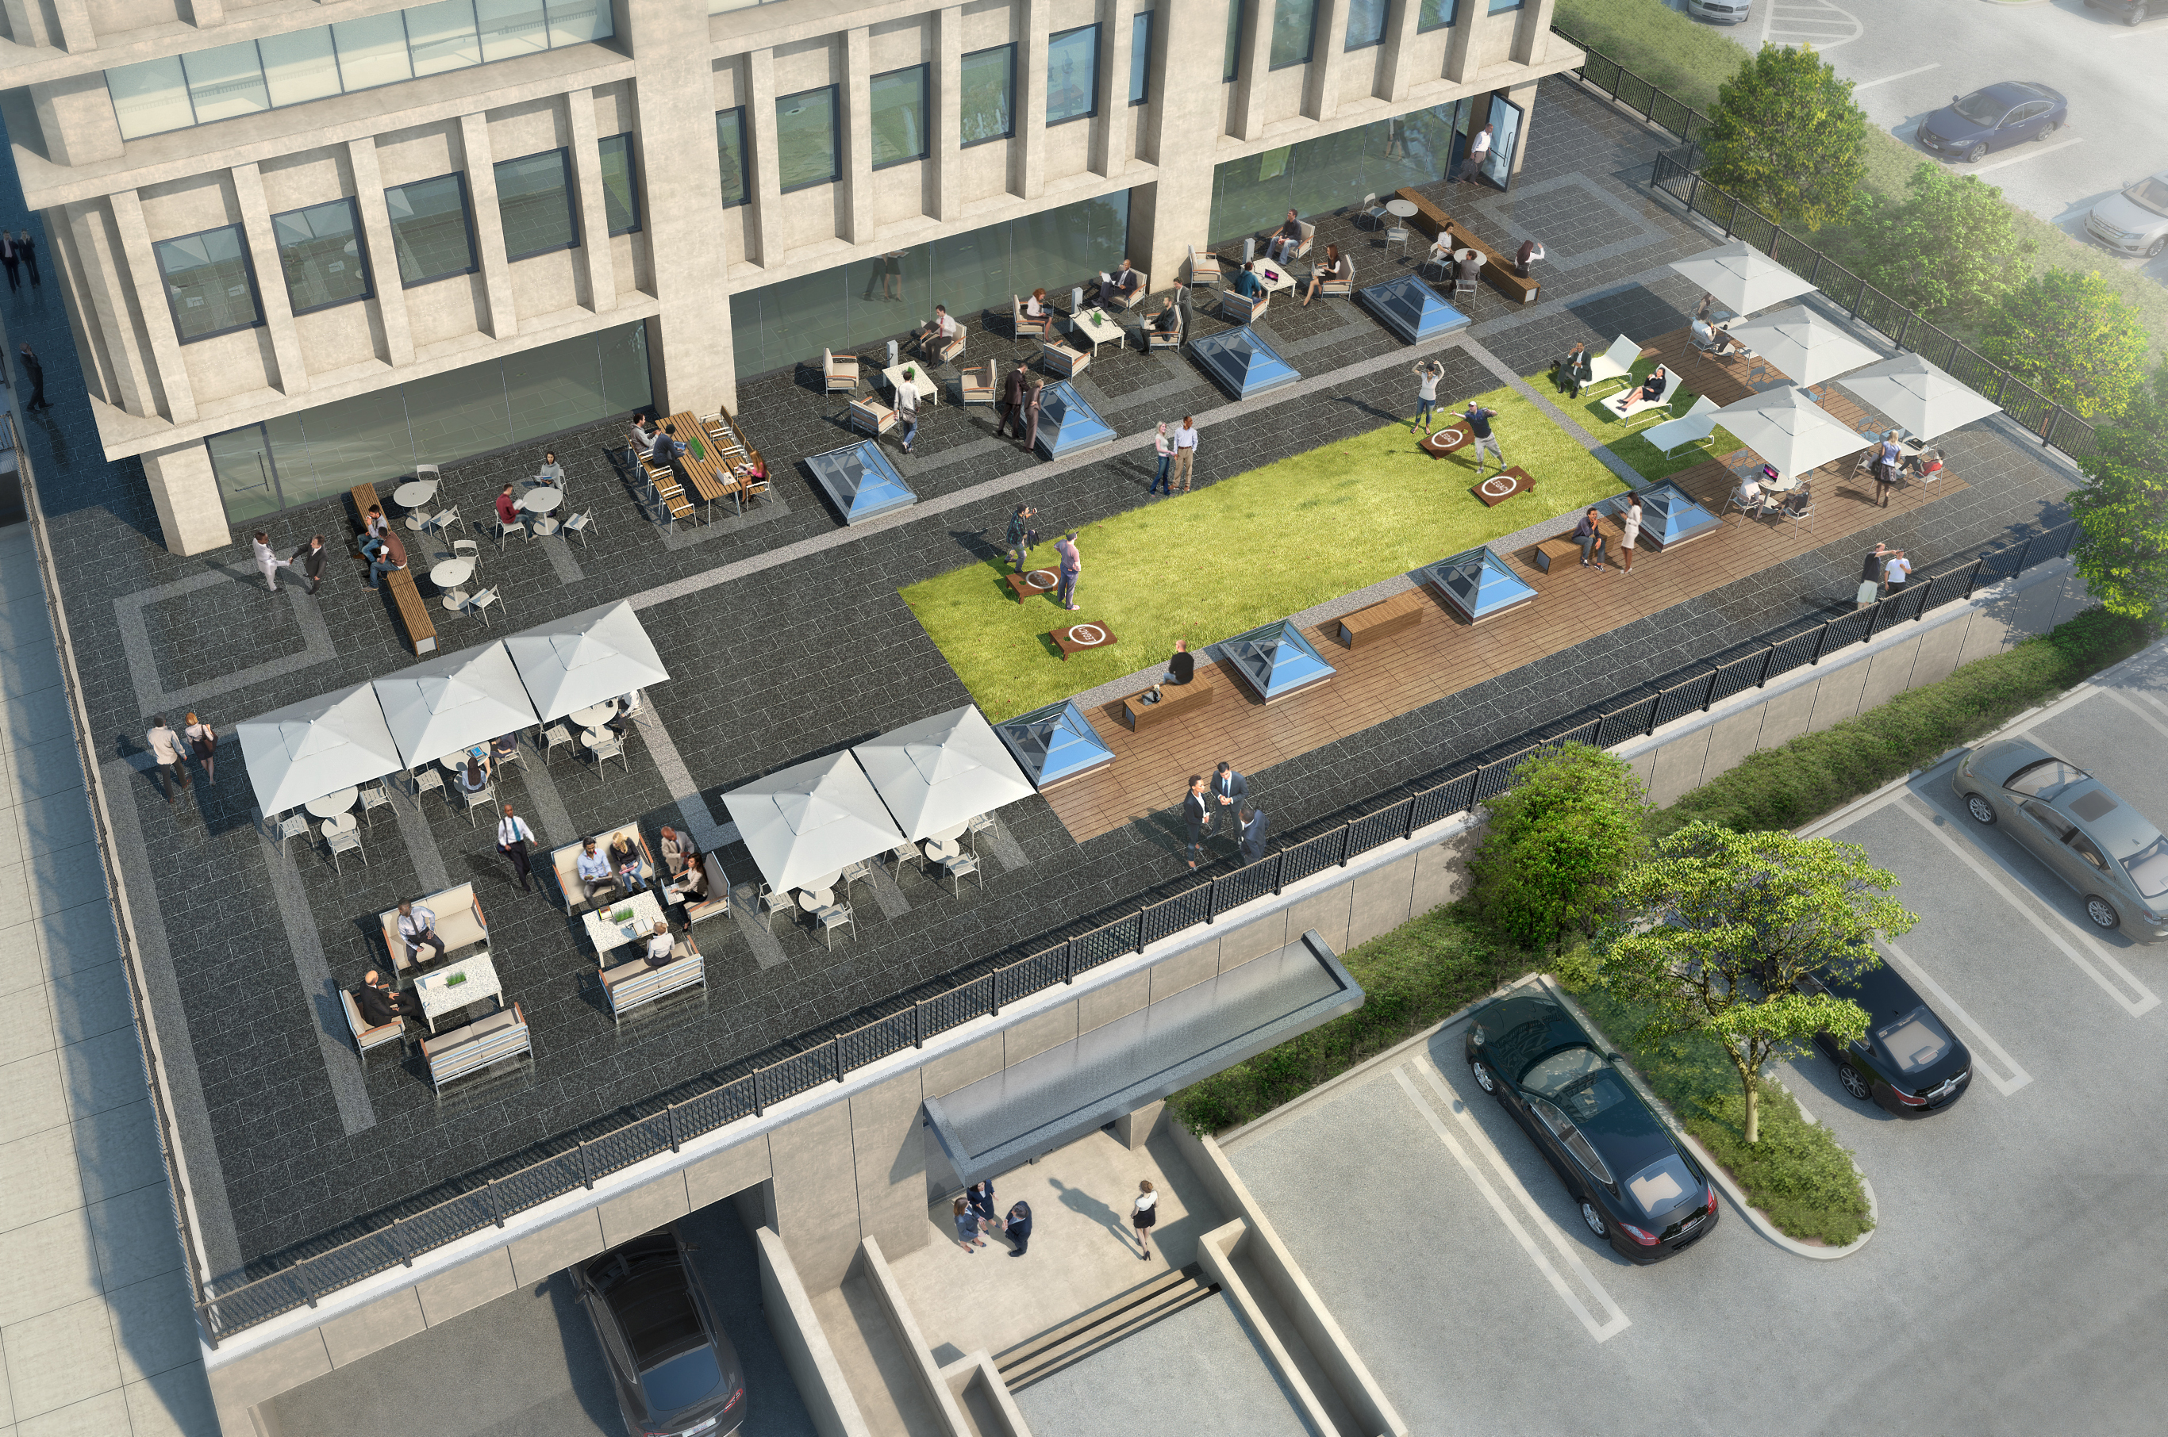
OUTDOOR TERRACE WORK SPACE
Stone paving and synthetic lawn
Seating areas framed by skylights
Variety of tables, benches, chairs, and umbrellas
Wi-Fi and power outlets for outdoor work
Delivery in Q3 2018

Slide 7

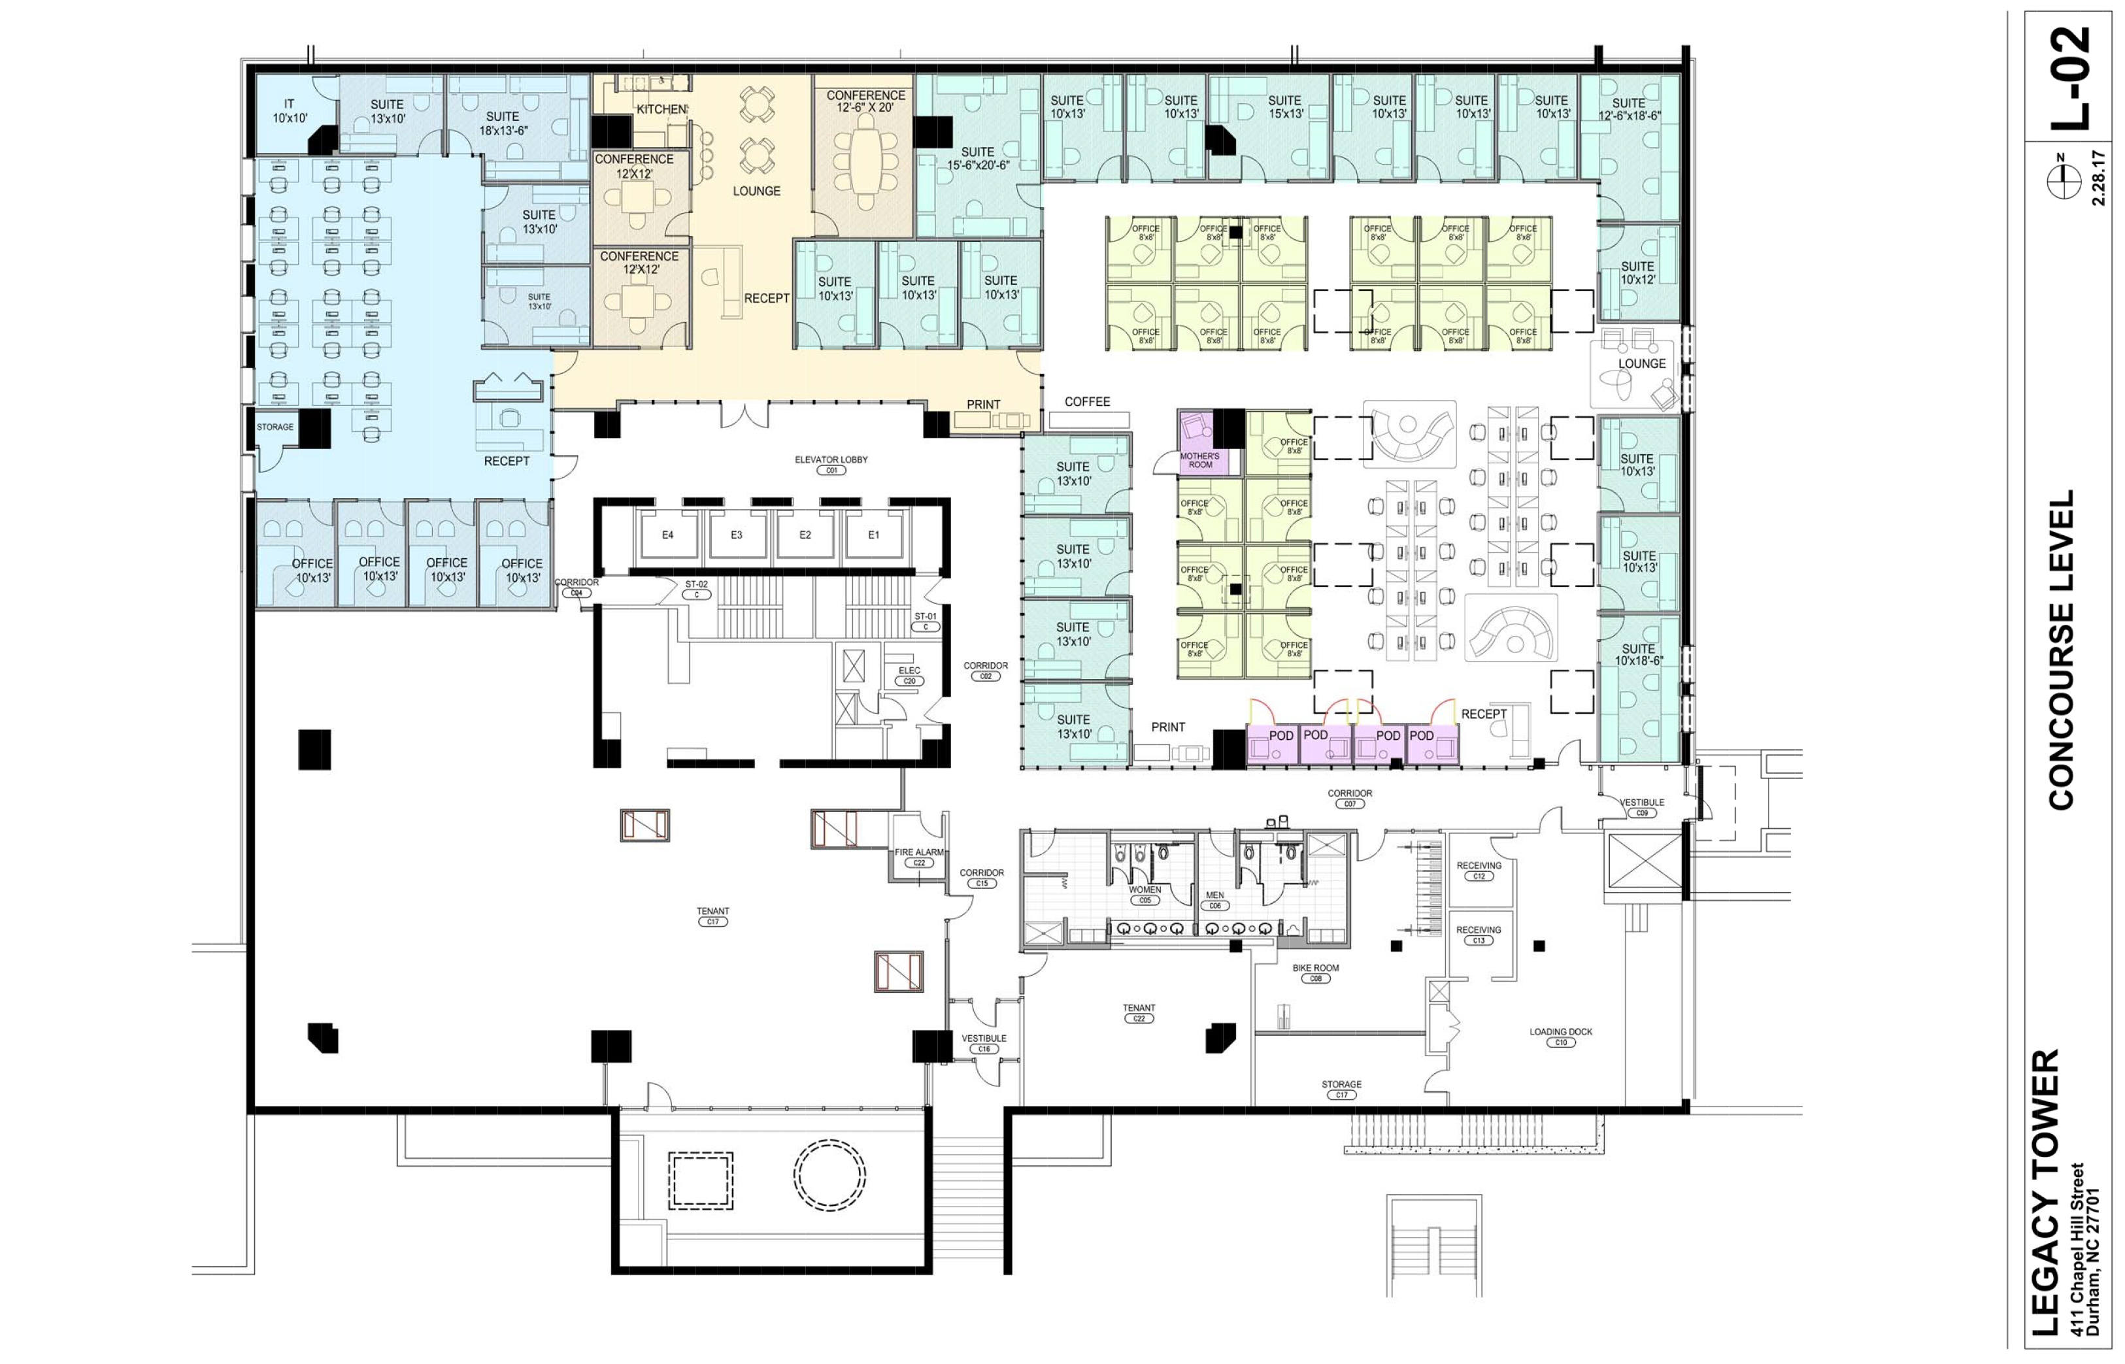
REDEVELOPED LOWER LEVELS
New amenities include: AV-equipped conference room, fitness center, locker rooms, tenant storage rentals, bike parking
Skylights and clerestory windows provide daylight into Concourse with access flooring
15,000-square foot shared office and co-working environment
Delivery in Q4 2018

Slide 8
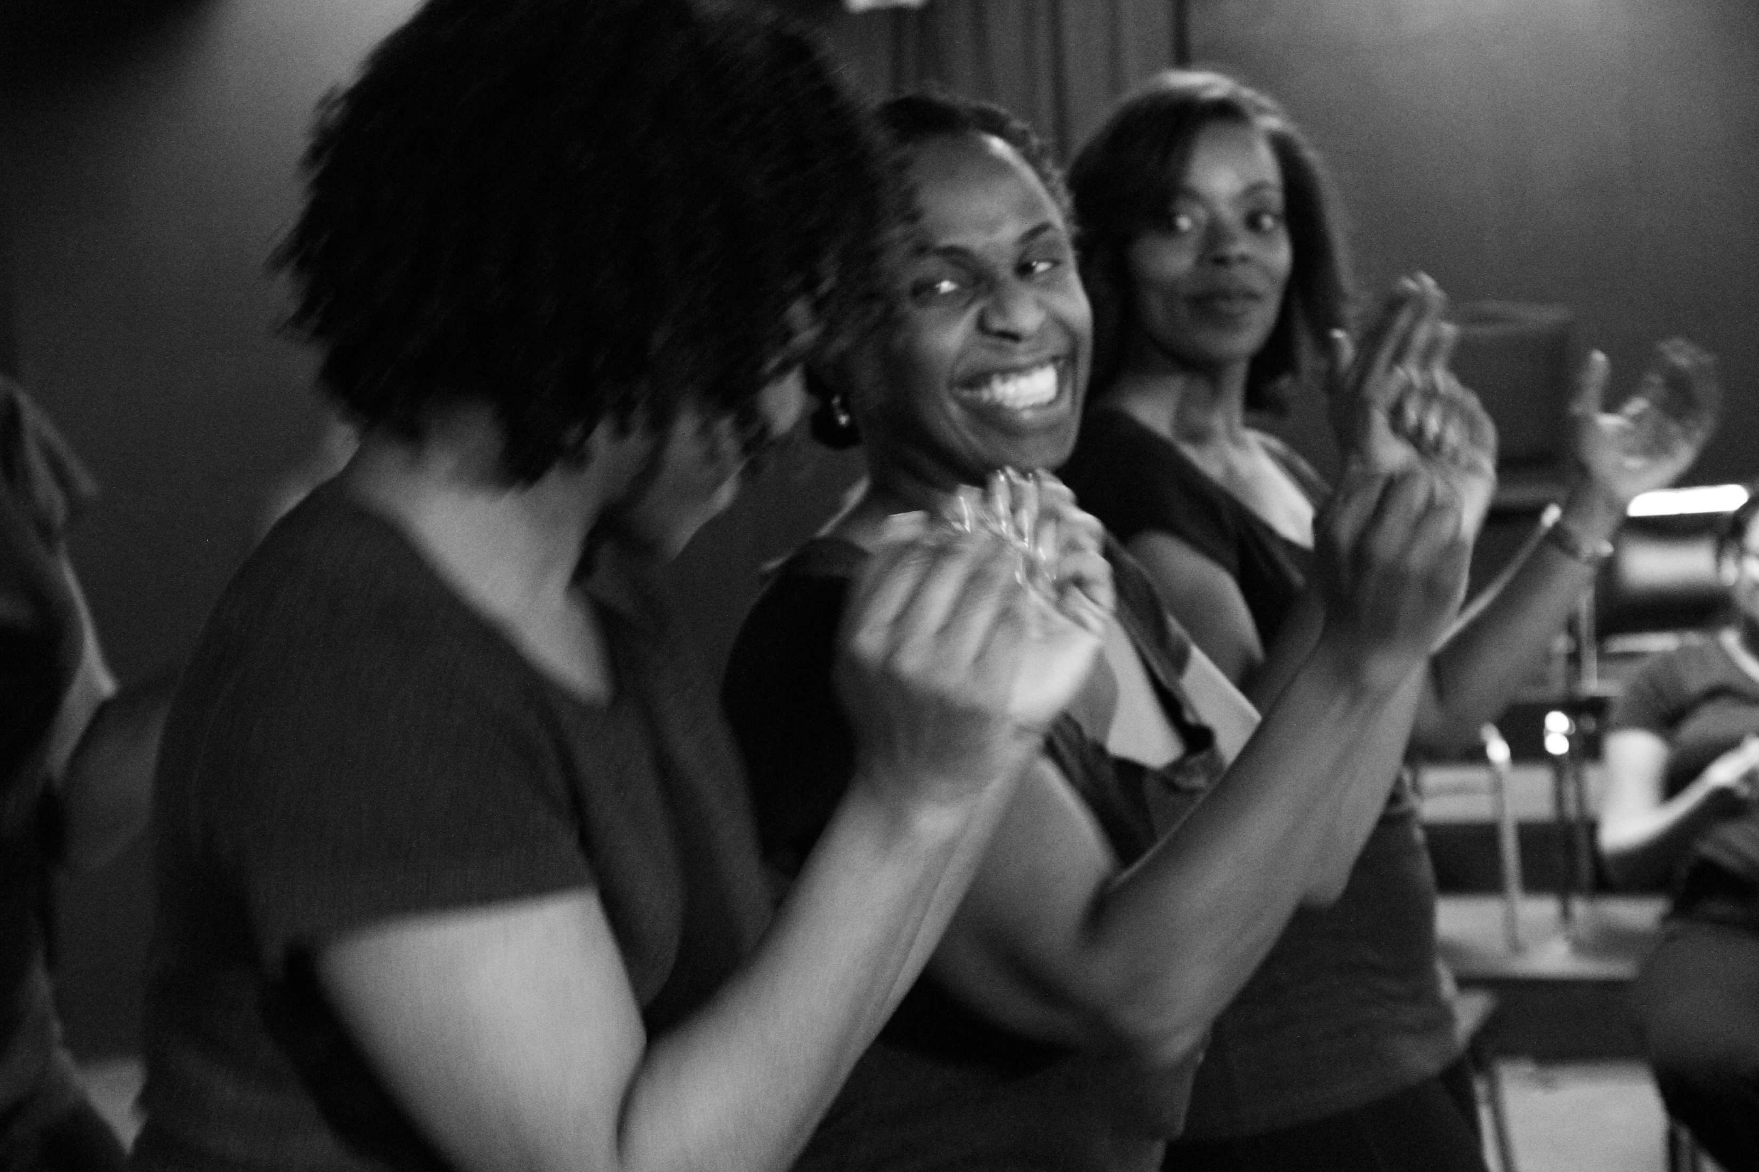
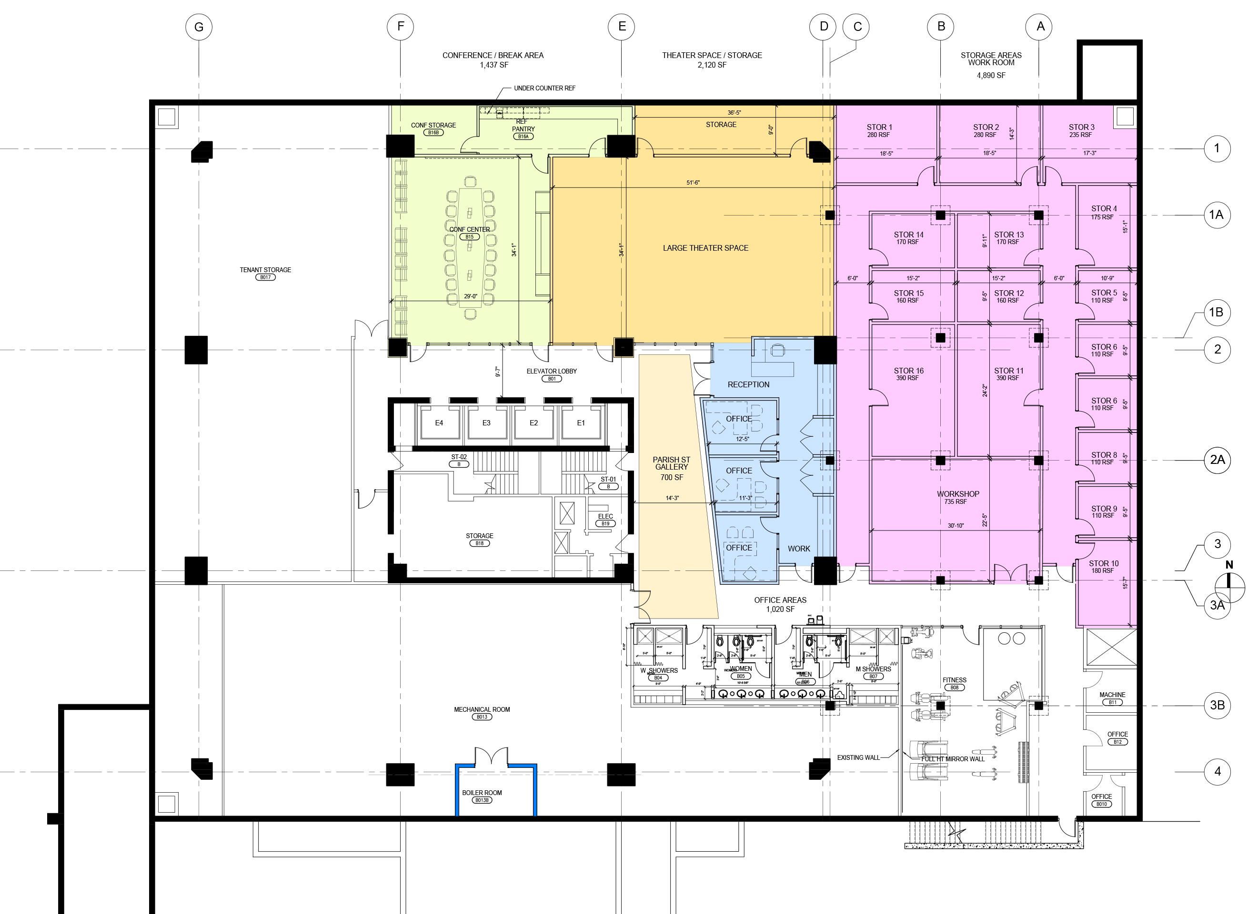
NEWLY-DEVELOPED CREATIVE CLASS SHARED WORK SPACE
Space for artists and scholars
Black box theater
Rehearsal studios
Art gallery
Workshop space
Conference room
Storage

Slide 9
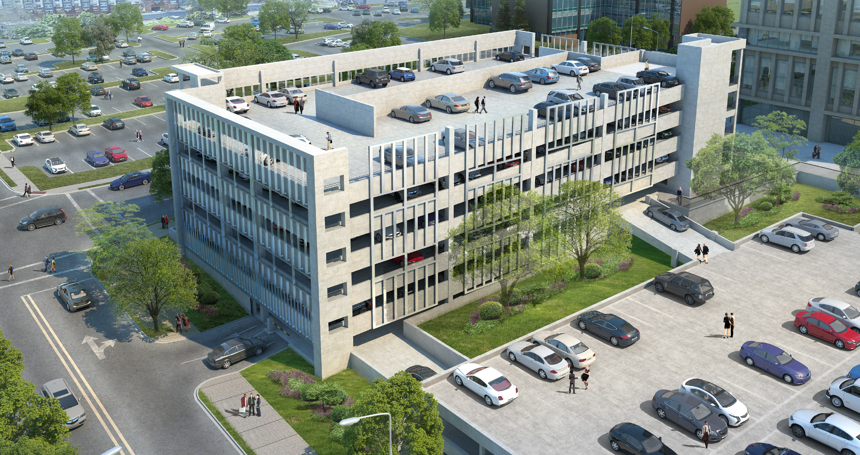
EXPANDED PARKING
New structured parking deck in place of surface lot
On-site parking ratio of 3 spaces per 1000 RSF
Skin to reflect geometry of historic tower
Expected delivery in 2019

Slide 10






TENANTS
A broad mix of current tenants represent world-class brands
NC Mutual
Duke University
Duke Health
Veterans Affairs (U.S. Government)
GoTriangle
Perkins + Will

Slide 11
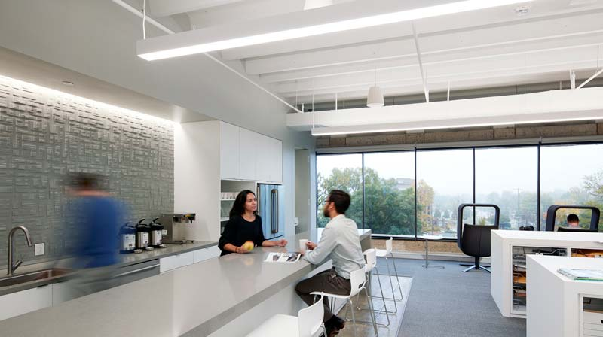
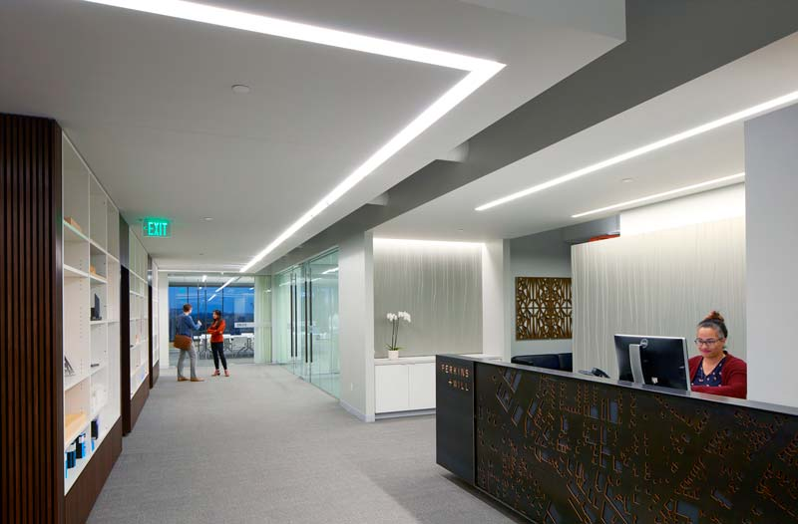
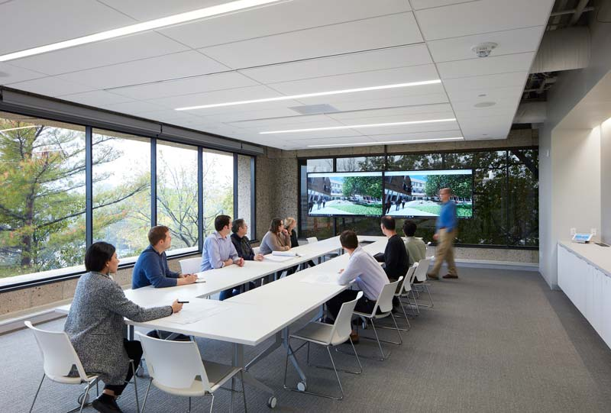
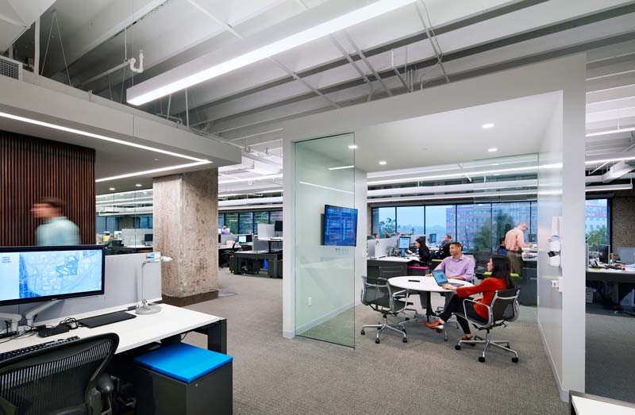
PERKINS + WILL SPACE

Slide 12
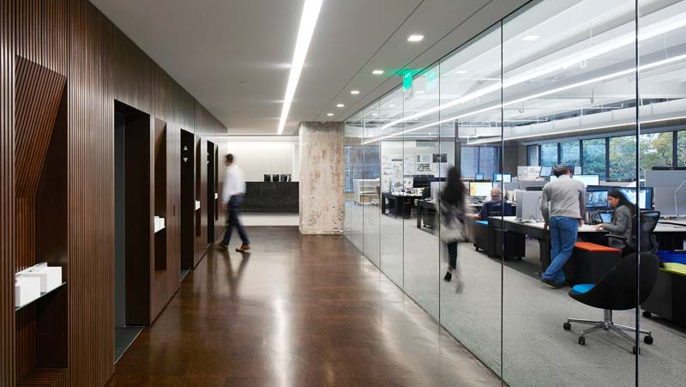
CASE STUDY: PERKINS + WILL SPACE
Open floor plan takes advantage of clear spans and maximize daylight
LED lighting, millwork, and ceiling accents emphasize clean lines of original architecture
Exposed ceiling to concrete structure accentuates minimalist, industrial look

Slide 13
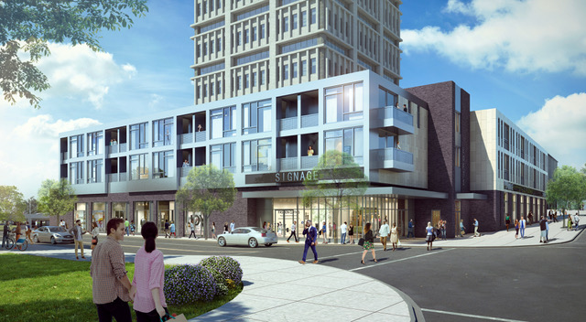
FUTURE DEVELOPMENT
Reflecting the vibrancy of downtown Durham

Slide 14
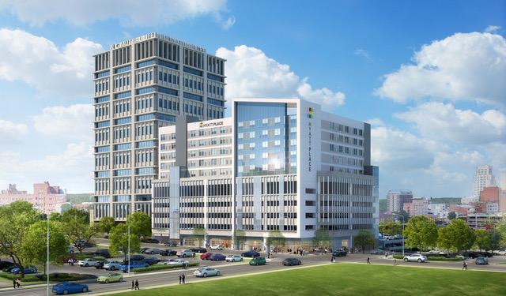
PLANNED INVESTMENTS
An upscale hotel stacked on new parking deck at corner of Duke St. and Jackson St.
A residential condo project above street-level commercial along Chapel Hill St. and Willard St.
Expected delivery in 2019/20.

